Slide 1
Automotive Open Source Platform Using Yocto Project

Slide 2
Objectives
Objective:
Introduction of Automotive Open Source Platform
Speaker: Changhyeok Bae (changhyeok.bae@lge.com)
Software Center in LG Electronics

Slide 3
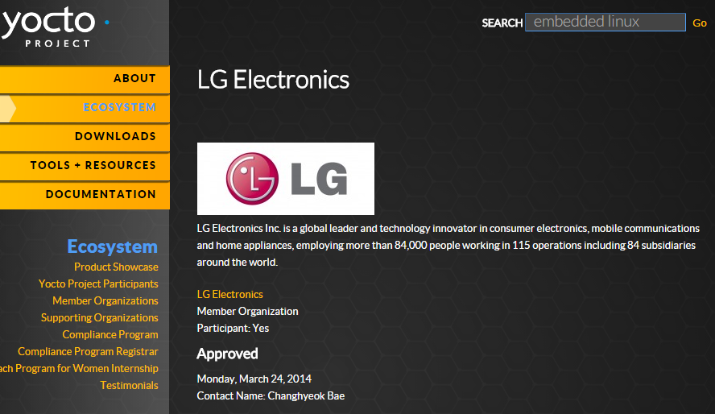
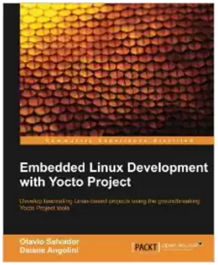
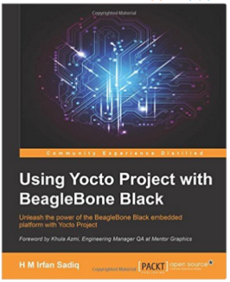
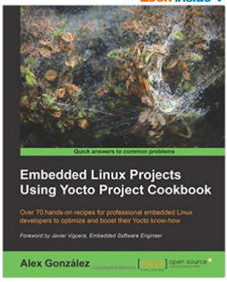
About me
Name: Changhyeok Bae (changhyeok.bae@lge.com, http://www.yocto.co.kr/)
Organization: LG Electronics Software Center
Activities:
GENIVI Development Platform (GDP) Maintainer
OpenEmbedded TSC (Technical Steering Committee)
Yocto Board / Tech Member in LG Electronics
오픈소스 프론티어 4기
2017~ 2018: Automotive Open Source Platform Using Yocto Project
2014
2015
2016

Slide 4
Contents
Yocto Project
Automotive Open Source Platform
GENIVI
AGL (Automotive Grade Linux)

Slide 5
Yocto Project

Slide 6



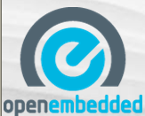
Build System
Embedded Linux가 보편화 되면서 다양한 cross platform에 맞는 Build 요구사항 증가
Kernel, toolchain등 target에 맞는 rootfs 이미지를 만들어 주는 build tool

Slide 7
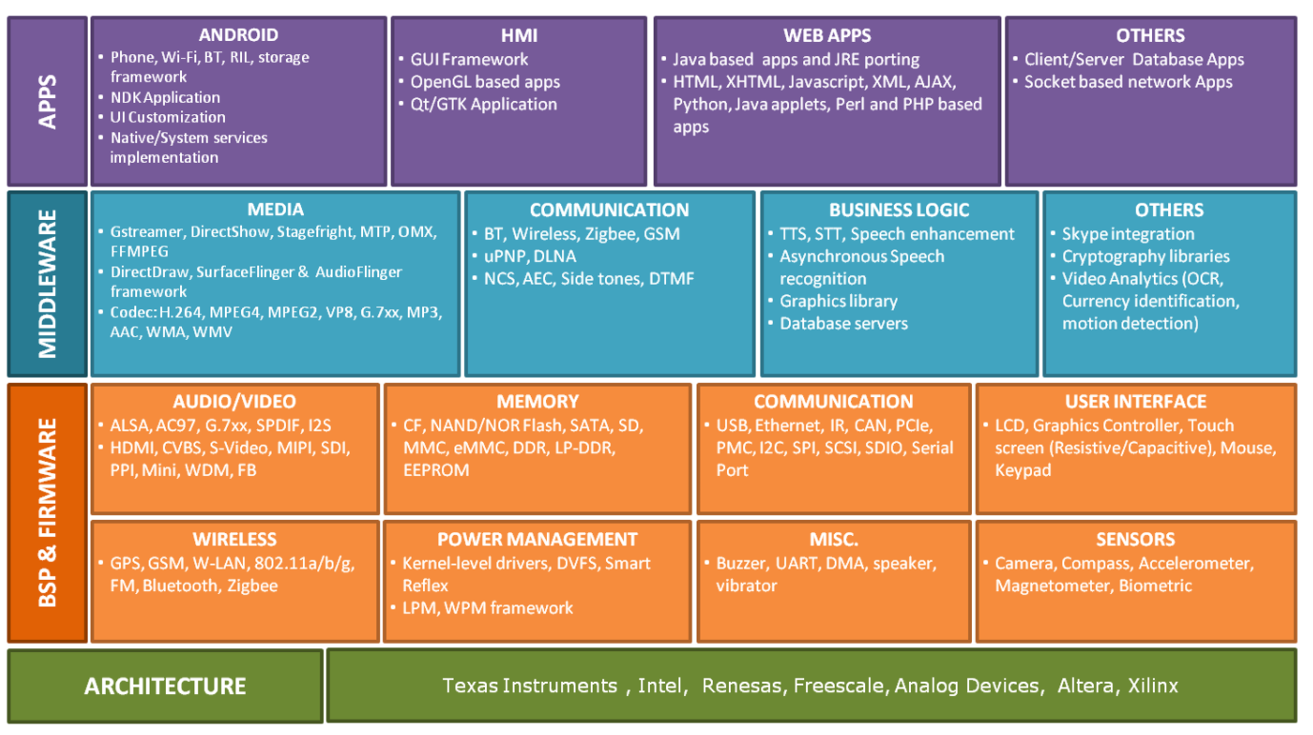
Embedded Linux Services
https://www.mistralsolutions.com/product-engineering-services/expertise/embedded-linux-services/

Slide 8
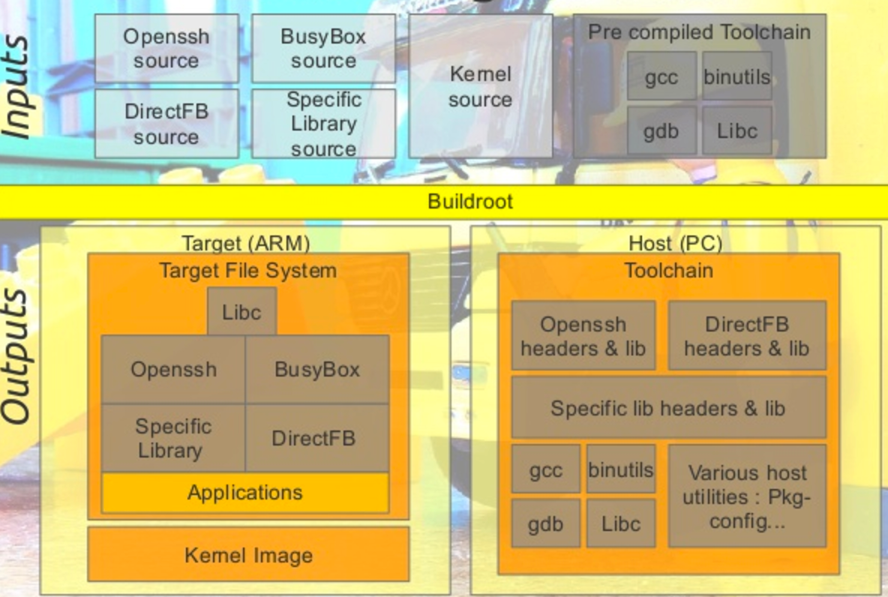
Build System for Embedded Linux
Toolchain

Slide 9
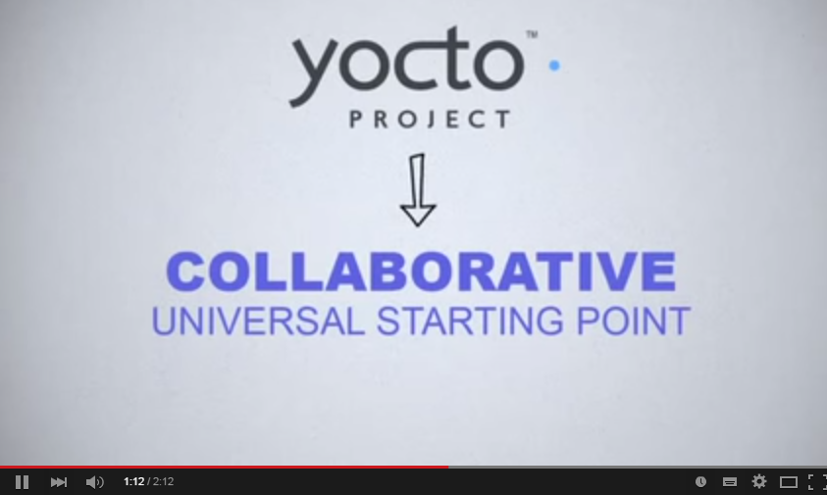
Yocto Project?
Notes:
2분 10초 동영상

Slide 10
Yocto Project?
open source collaboration project (umbrella project under Linux Foundation)
provide templates, tools and methods
help you create custom Linux-based systems for embedded products
regardless of the hardware architecture (x86, ARM, MIPS, Power)

Slide 11
Yocto Project Release
Name | Revision | Poky | Release Date
Bernard | 1.0 | 5.0 | Apr 2011
Edison | 1.1 | 6.0 | Oct 2011
Denzil | 1.2 | 7.0 | Apr 2012
Danny | 1.3 | 8.0 | Oct 2012
Dylan | 1.4 | 9.0 | Apr 2013
Dora | 1.5 | 10.0 | Oct 2013
Dasiy | 1.6 | 11.0 | Apr 2014
Dizzy | 1.7 | 12.0 | Oct 2014
Fido | 1.8 | 13.0 | Apr 2015
Jethro | 2.0 | 14.0 | Nov 2015
Krogoth | 2.1 | 15.0 | Apr 2016
Morty | 2.2 | 16.0 | Oct 2016
Pyro | 2.3 | 17.0 | Apr 2017
Rocko | 2.4 | 18.0 | Oct 2017
https://wiki.yoctoproject.org/wiki/Releases

Slide 12
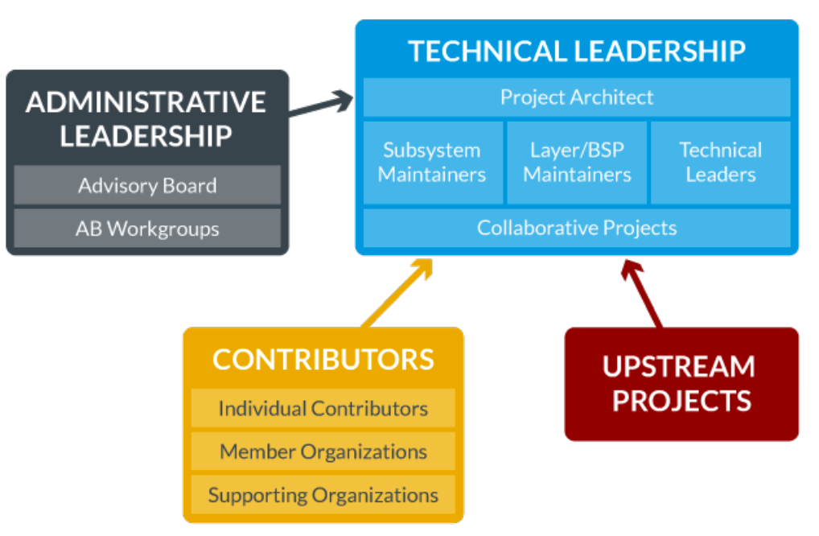
COMMUNITY

Slide 13
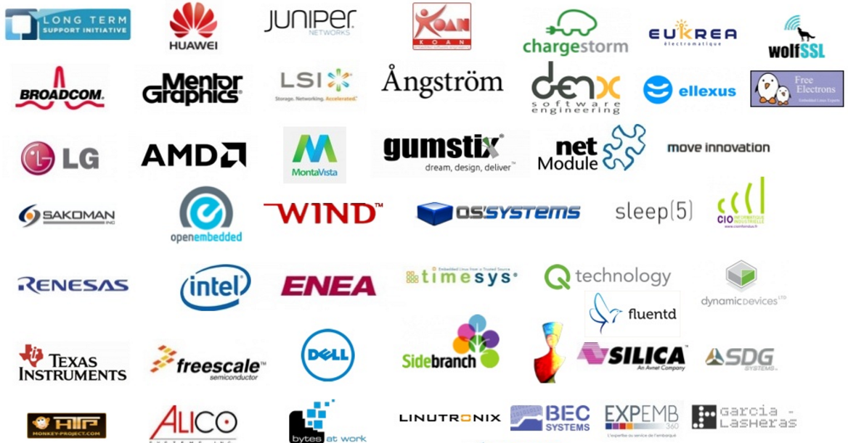
Participating Organizer

Slide 14
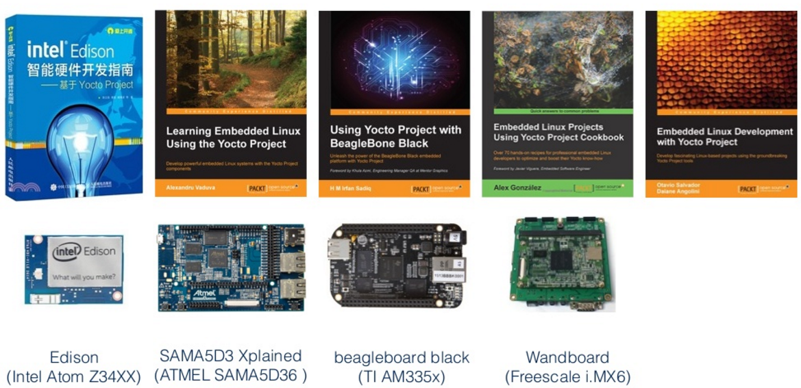
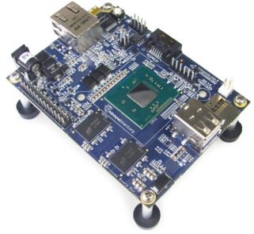
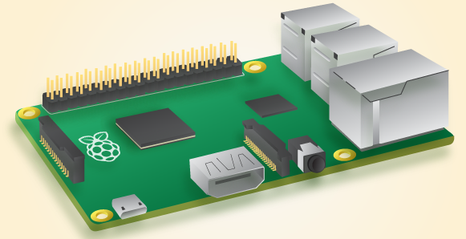
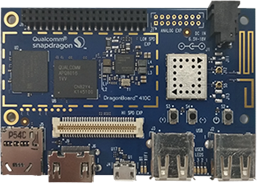
Books
MinnowBoard MAX
(Intel Atom E38xx)
Raspberry Pi0,1,2,3
(ARM Cortex-A7)
DragonBoard 410c
(ARM Cortex-A53)

Slide 15
Yocto Project Documents
BitBake Manual
Toaster Manual
Yocto Project Board Support Package (BSP) Developer’s Guide
Yocto Project Development Manual
Yocto Project Linux Kernel Development Manual
Yocto Project Profiling and Tracing Manual
Yocto Project Quick Start
Yocto Project Reference Manual
Yocto Project Software Development Kit (SDK) Developer’s Guide
https://www.yoctoproject.org/documentation

Slide 16
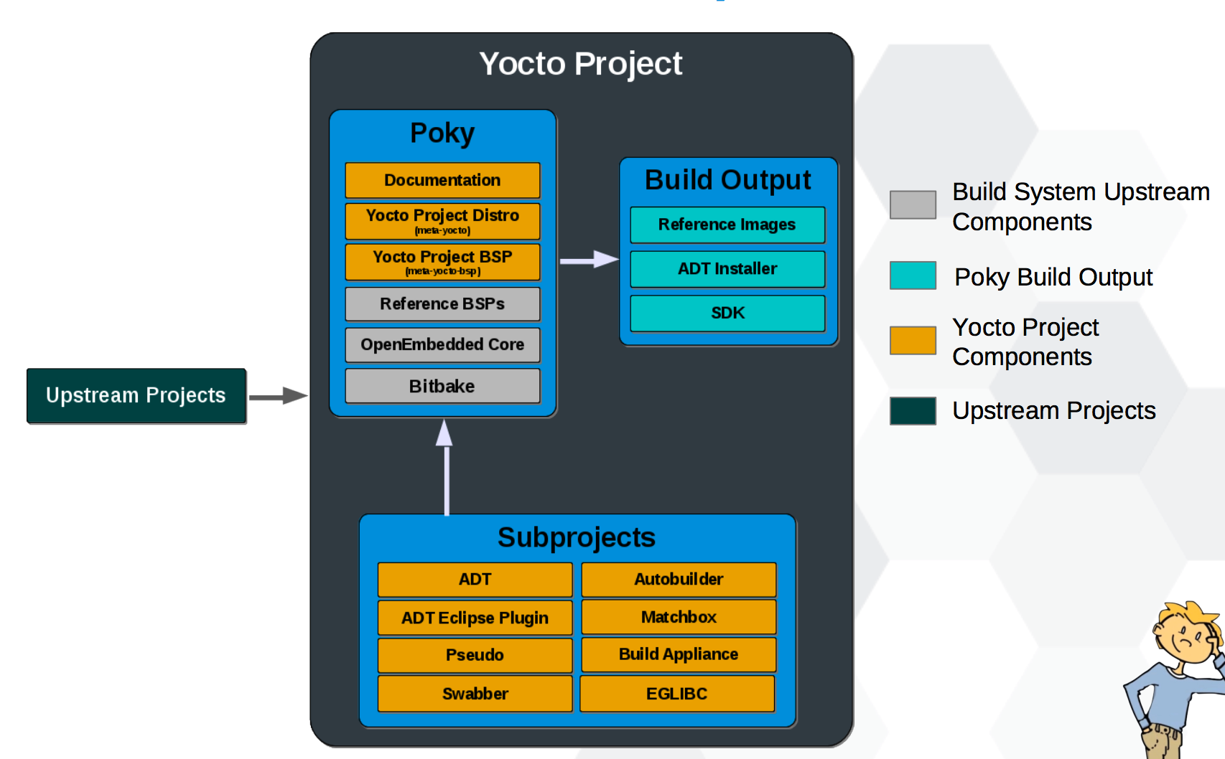
Yocto Project Family

Slide 17

OpenEmbedded
개요
임베디드 리눅스 배포한 구축을 위한 빌드 프레임워크
2003년 1월에 시작
OE Classic에서 OE Core로 발전됨
Python 기반의 bitbake 빌드 툴을 사용함
OE Core 부분을 Yocto Project와 공유함
지향점은 다양한 architecture, feature application을 제공
장점
HW 독립적인 개발 용이함: machine type (arm, ppc, mips, x86)을 수정함
meta file 유지 보수가 쉬움: .bbappend 로 추가 사항 변경
다양한 Image format 및 package 지원: ext, ext3, tar, jffs … , ipk, dpkg, rpm …
다양한 형상관리 Protocol 지원: git, svn, cvs, http, ftp, …
단점
개발 환경 (bitbake) 적응 필요
속도가 늦고, 큰 개발 공간 필요 : share sstate 공유를 통해 일부 해결 가능함
https://yoctoproject.org/downloads http://www.openembedded.org/wiki/Main_Page
http://www.openembedded.org/wiki/OpenEmbedded-Core
https://www.youtube.com/watch?v=zNLYanJAQ3s

Slide 18

Bitbake 와 Metadata
Bitbake
Powerful and flexible build engine
Determines dependencies and schedules tasks
Metadata – structured collection of “recipes” which tell Bitbake what to build

Slide 19
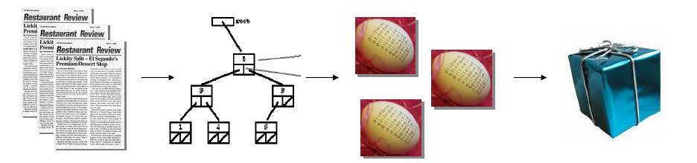
bitbake
python과 shell script로 코드를 실행하는 태스크 스케쥴러
(GNU make와 비슷하다고 이해하면 됨)
병렬 실행 지원
OpenEmbedded와 Yocto Project에서 ‘빌드’에 사용함
bitbake에 의한 빌드 작업의 수행은
메타 데이터 (.conf, .bbclass, .bb & .inc)를 기반으로
‘패키지’간의 ‘dependency를 분석하여 작업 그래프를
만들고, 각 패키지를 빌드하고 통합하여 이미지를 생성함
metadata
& recipes
package & task
graph
packages
image
각 패키지에 대한 빌드 동작은
Git, SVN 등으로부터 소스를 다운받고 (fetch),
수정사항을 적용하며 (patch),
컴파일 환경을 설정 (configure)후,
컴파일(compile),
설치(install)의 등의 단계로 처리함
각 단계를 task 라고 하며, 이것은 각 모듈마다
recipe (*.bb) 라는 파일에 기술되어 있음
/
fetch : git, svn등으로 부터 소스 download
unpack : 다운 받은 archive(*.tar.gz)를unpack : ${S} 디렉토리
patch : unpack한 소스에 patch를 적용
configure : 패키지 configure 예) ./configure <options>의 동작 수행
compile : compile 예) make
install : ${D}경로에 설치 예) install 명령
package : install된 파일을 선별하여 package 디렉토리에 복사
package_write : ipk 파일 생성
popluate_sysroot : 빌드시 사용하는 header, lib파일을 지정 디렉토리에 복사

Slide 20
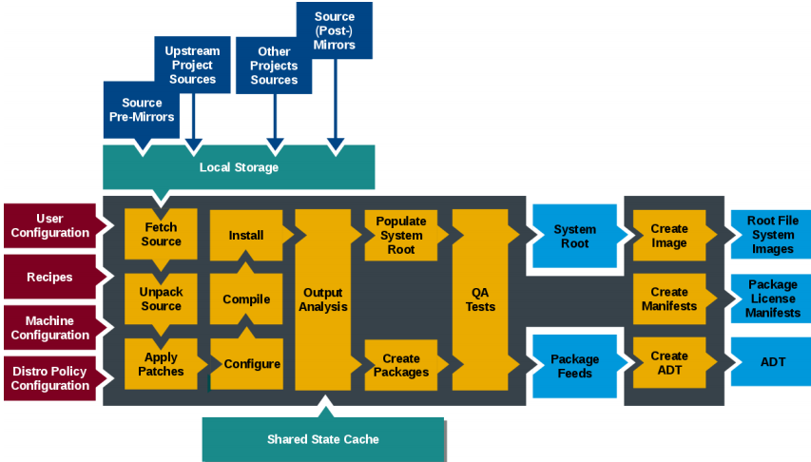
Build System Workflow

Slide 21
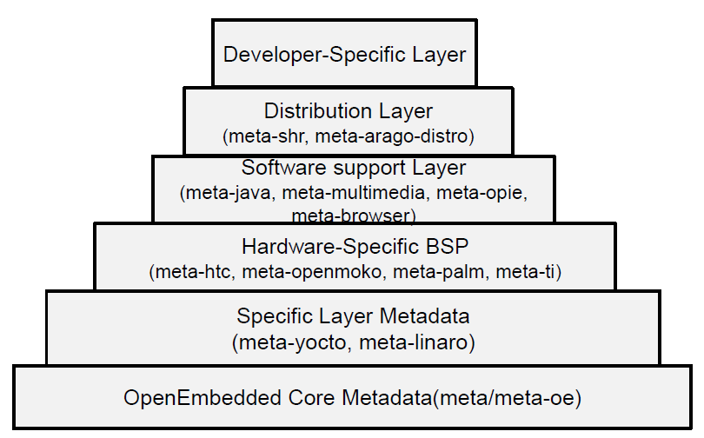
OpenEmbedded Layer

Slide 22
2. Automotive Open Source Platform

Slide 23
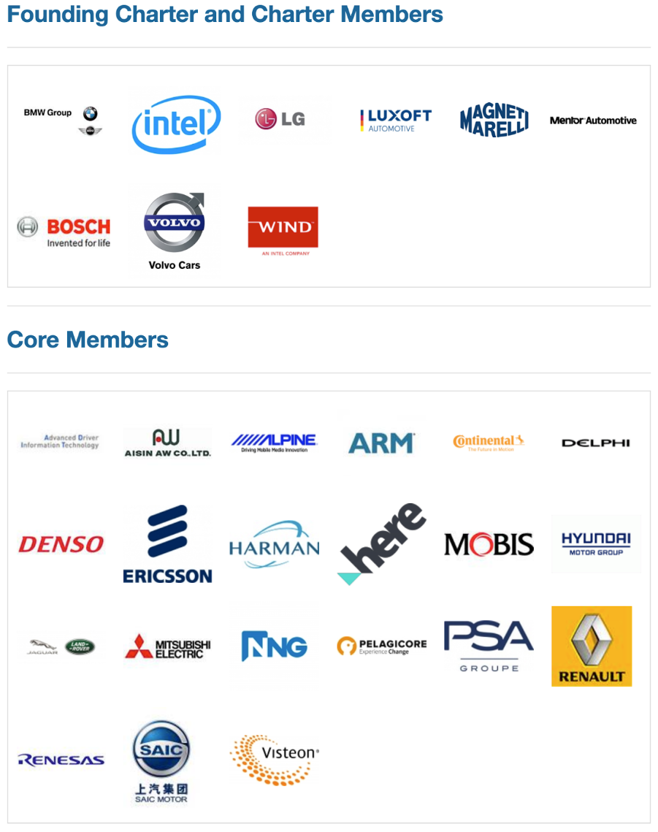
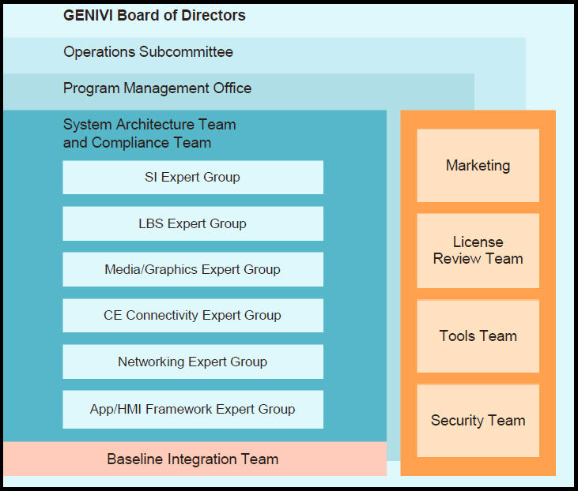
GENIVI
GENIVI® is a nonprofit industry alliance committed to driving the broad adoption of specified, open source, In-Vehicle Infotainment (IVI) software.

Slide 24

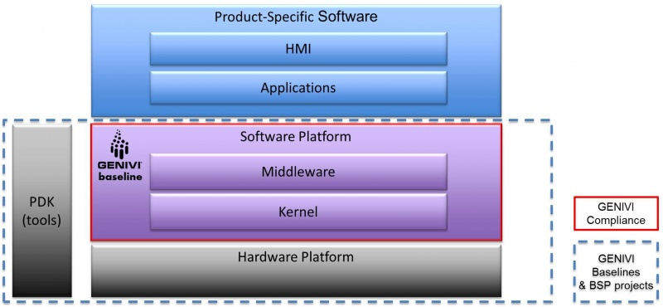
GENIVI Baseline
The meta-ivi based Yocto GENIVI Baseline is a GENIVI compliant Linux distribution for a variety of embedded devices. The meta-ivi project aligns itself with The Yocto Project, and the distribution is the result of making the Yocto Project reference system Poky GENIVI compliant.

Slide 25
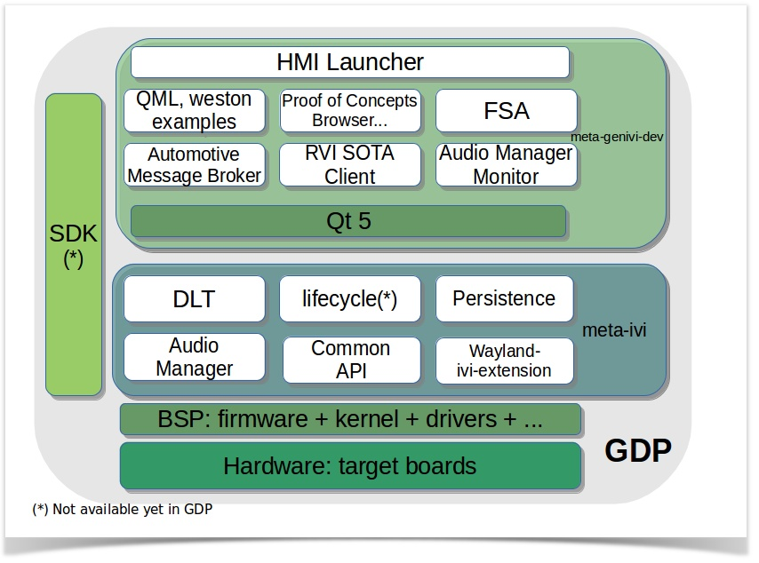
GENIVI Development Platform (GDP)
The GENIVI Development Platform is a technology demonstrator.
It is made available as a starter kit that can be publicly downloaded and customized by the wider developer community.
Supporting Board : qemux86, Intel Minnowboard MAX, Renesas Porter, Raspberry Pi 2,3, Qualcomm Dragonboard

Slide 26
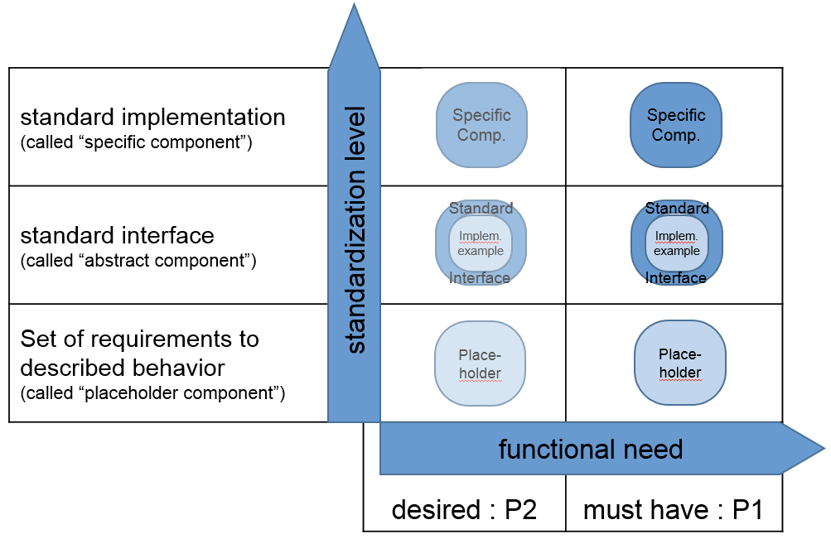
GENIVI Software
GENIVI는 여러 소프트웨어 모듈을 우선 순위에 따라 P1 (Mandatory), P2 (Desirable)로 구체화 정도에 따라 PC (Placeholder Component), AC (Abstract Component), SC (Specific Component)로 나누어진다.

Slide 27
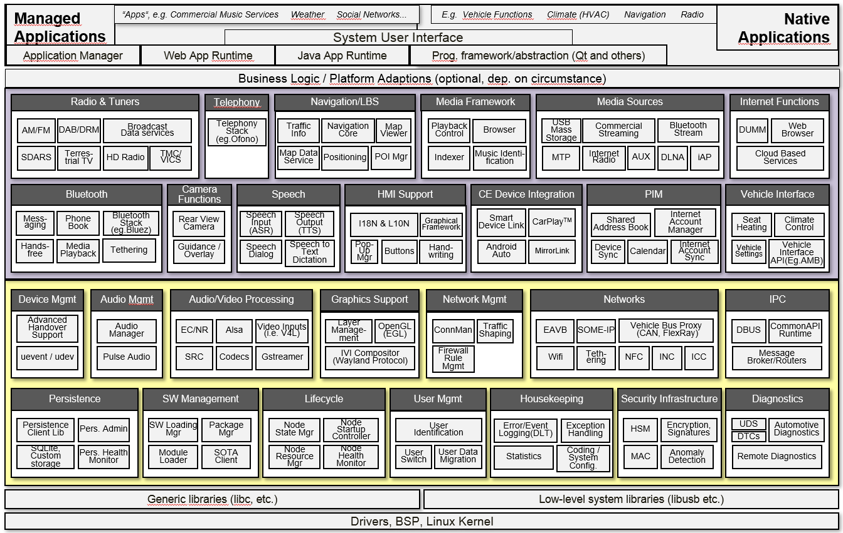
GENIVI Architecture

Slide 28
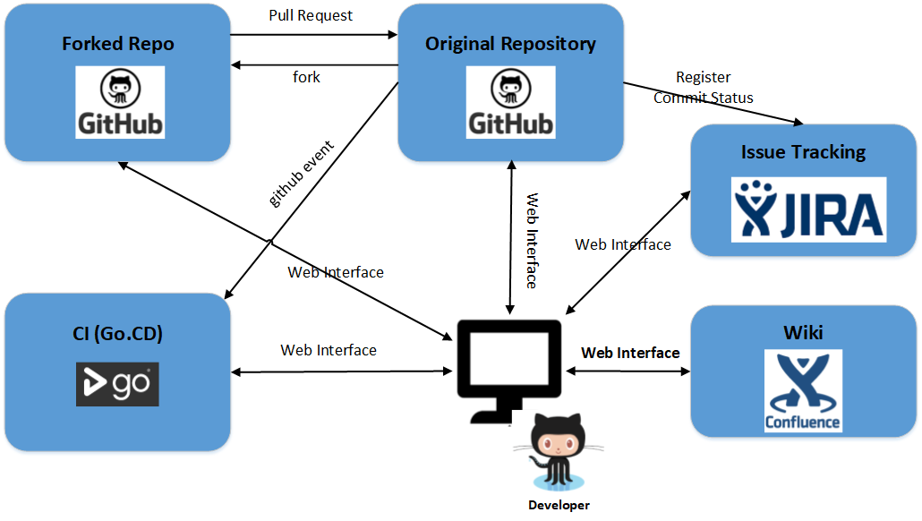
GENIVI Development Environment

Slide 29
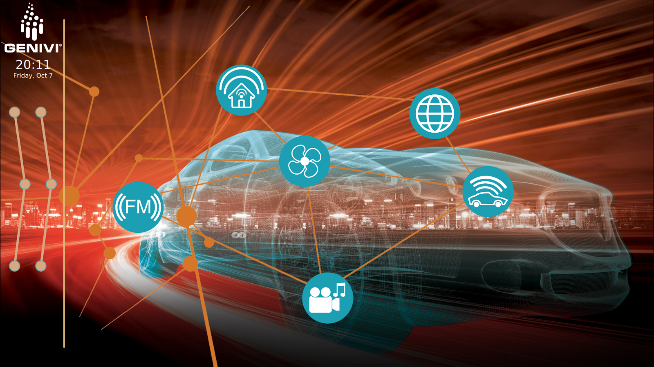
How to build GENIVI
$ git clone https://github.com/GENIVI/genivi-dev-platform
$ cd genivi-dev-platform
$ source init.sh qemux86-64
$ bitbake genivi-dev-platform

Slide 30
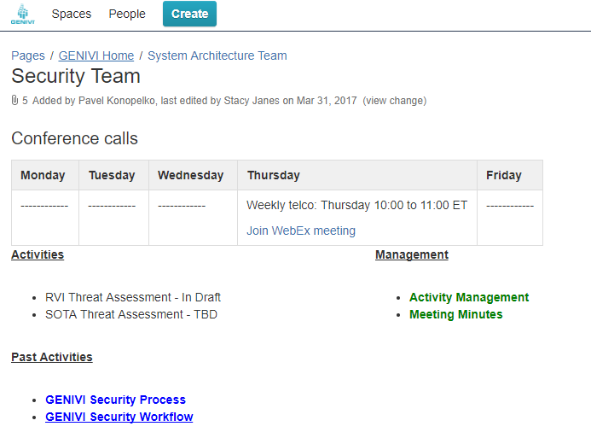
GENIVI Security Team

Slide 31
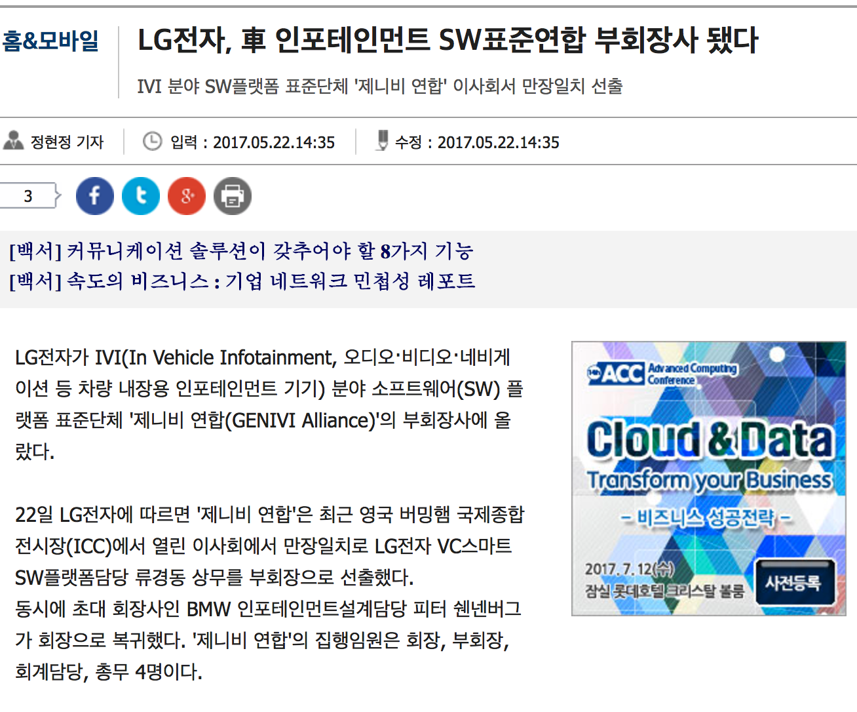
GENIVI 최신 동향
GENIVI All Member Meeting
Oct 10-12, 2017
Grand Hyatt Hotel, Seoul, Korea
http://www.zdnet.co.kr/news/news_view.asp?artice_id=20170522142956

Slide 32
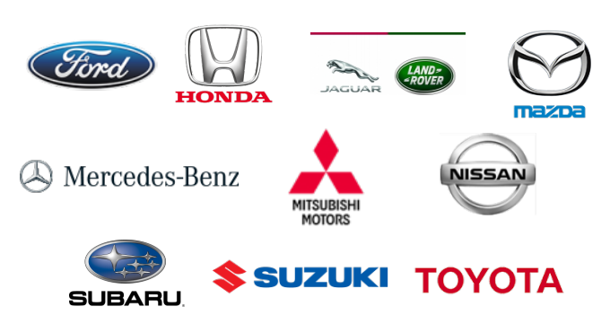
AGL (Automotive Grade Linux)
Release (Fish name)
AA – Agile Albacore – Jan 2016
BB – Brilliant Blowfish – June 2016
CC – Charming Chinook – Dec 2016
DD – Daring Dab – July 2017
EE – Electric Eel – Dec 2017
FF – Funky Flounder – July 2018
Linux Foundation Collaborative Project
Leverage Linux and Open Source technologies
Build standardized platform(s) and app framework for the entire industry and for all functions in the vehicle
http://www.mostforum.com/media/presentations/MOST-Forum-2016-p09-Linux-Foundation.pdf

Slide 33
Goals of AGL
Build a single software platform for the entire industry
Develop 70~80% of the starting point for a production project
Reduce fragmentation by combining the best of open source
Develop an ecosystem of developers, suppliers, expertise all using a single platform

Slide 34
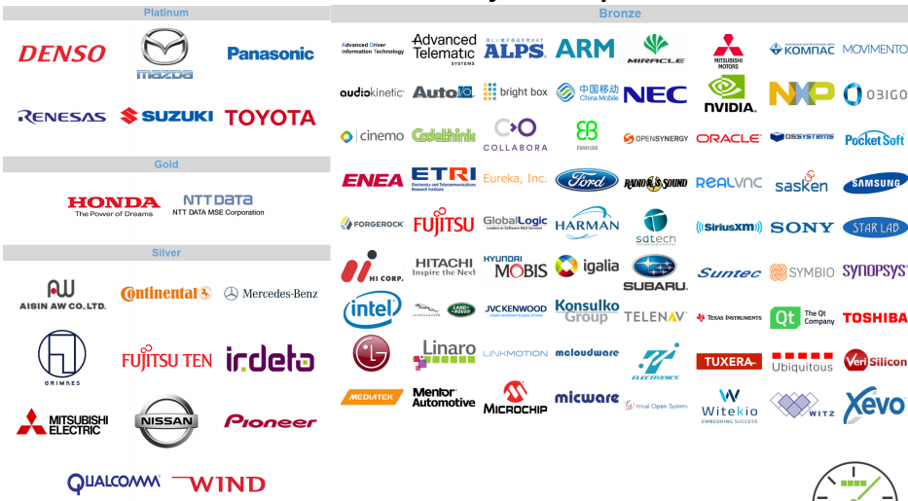
AGL Members – 98 Companies

Slide 35
AGL is CODE FIRST
AGL is a “Code First” organization!
Specifications lead to fragmentation!

Slide 36
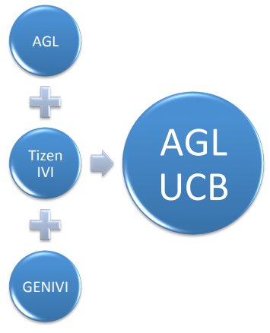
AGL (Automotive Grade Linux)
Distro: Unified Code Base
Reduce fragmentation, focus on innovation and new features
Yocto / Poky based with AGL specific layers
Reference BSP – Fully supported by manufacturer
Reneses Porter (M2)
QEMU x86-64
Intel Minnowboard MAX
Community BSP – Best effort by AGL
Raspberry PI 2/3
Qualcomm Dragonboard
NXP Wandboard
….

Slide 37

Brillant Blowfish
Released July 15, 2016
Yocto 2.0 (Jethro)
Additional BSPs
IVI Audio Manager
IVI Layer Manager
Automated Test Improvements

Slide 38

Charming Chinook
Released December 15, 2016
Yocto 2.1 (Krogoth)
SDK available
Reference AGL Apps
AGL Compositor
AGL Home Screen Reference App in Qt and HTML5
Device Profiles for Telematics, IC, ADAS
IP Network Manager with Wifi and LTE

Slide 39

Daring Dab
Released July 2017
Yocto 2.2 (Morty)
App Framework Improvements
SOTA Updates
App Framework Service Binders
Audio Manager, Bluetooth, Tuner, CAN signaling, Media Scanner
API V2
SDK Improvements
Reference BSPs
Renesas R-Car 3 M3, TI – Jacinto
Community BSPs
Qualcomm SnapDragon 820
TI BeagleBone Black

Slide 40
Electric Eel - WIP
Will Release Dec, 2017
Yocto 2.3 (Pyro)
Rework Yocto Layers for headless devices
Window Manager and Graphics Architecture
Home Screen as an app
Audio Manager architecture
Additional Service Binders
Telephony
CI and Automated Test Improvements
CES 2018 Demo Apps

Slide 41
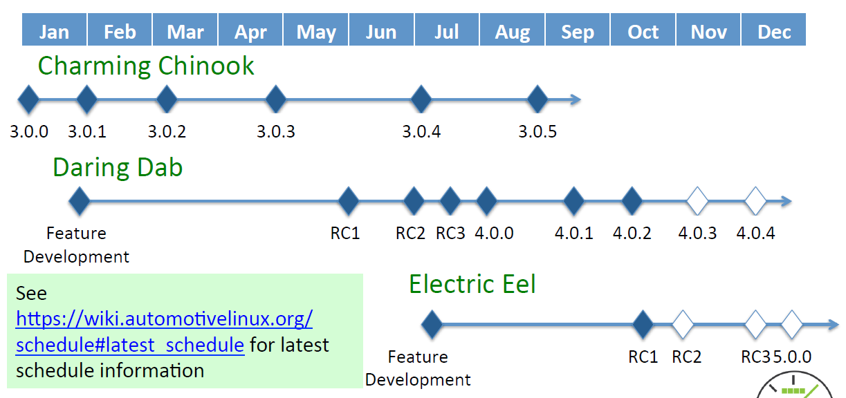
2017 AGL Schedule
http://schd.ws/hosted_files/aglammeu17/8f/AGL%20Roadmap%20Dresden%202017%20AMM.pdf

Slide 42
AGL Roadmap (2017/2018) – Presented in AGL AMM 2017
2017
All APIs available as APP FW service Binders
IC (Instrument Cluster), Telematics and other profiles
2018
Content Providers as AGL App
Functional Safety Initiative
Home Screen, Window Manager
Chromium based HTML5 Apps
App Framework Evolution
Reference Hardware System Architecture
http://schd.ws/hosted_files/aglammeu17/8f/AGL%20Roadmap%20Dresden%202017%20AMM.pdf

Slide 43
Expert Groups
Active
Application Framework and Security
Connectivity
Continuous Integration and Automated Test
Graphics and UI
Navigation
Virtualization
Reference Hardware System Architecture
Proposed
Vehicle to Cloud
Split off Security from App FW
http://schd.ws/hosted_files/aglammeu17/8f/AGL%20Roadmap%20Dresden%202017%20AMM.pdf

Slide 44
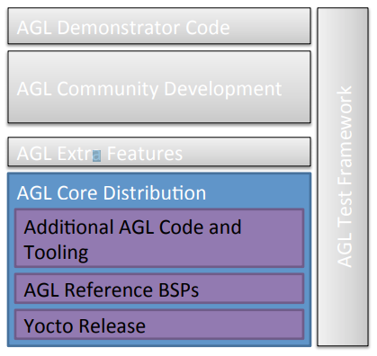
AGL Configuration – Core Distribution
Stable Yocto release
Reference BSPs
Documentation and tooling
Tooling to allow selection of optional features
Fully supported with updates for at least 6 months
Yocto Layer – meta-agl

Slide 45
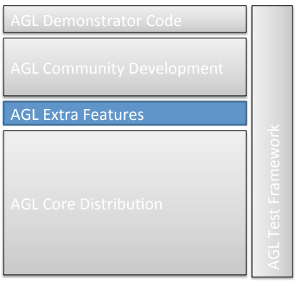
AGL Configuration – Extra Features
Build on AGL Core Distribution
Features are fully tested and supported as part of AGL release
Device profiles (e.g, Telematics, ADAS) will be provided in AGL Extra Features
Yocto Layer – meta-agl-extra

Slide 46
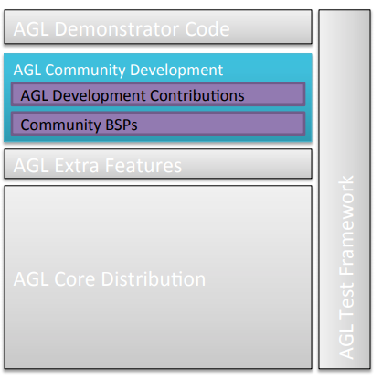
AGL Configuration – Community Development
Place for developing code that may eventually make it into AGL Core or Extra Features
Community BSPs
No formal QA
Yocto Layer – meta-agl-devel

Slide 47
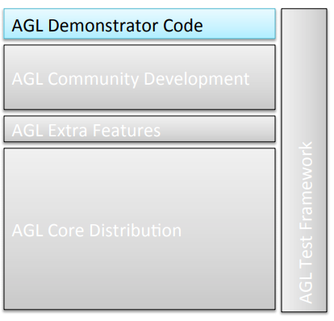
AGL Configuration – Demonstrator Code
Code developed to demonstrate specific features
Yocto Layer – meta-agl-demo

Slide 48
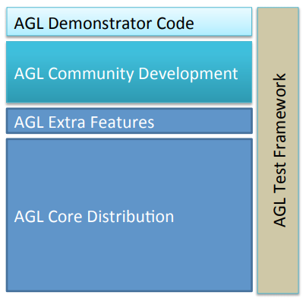
AGL Release Management
Twice per year
AGL Core Distribution and Extra Features
Full test results for reference BSPs
AS-IS demo code, Community Developed features, and BSPs
LTS (2+ years) for selected releases
Daily snapshot builds for specific configuration

Slide 49
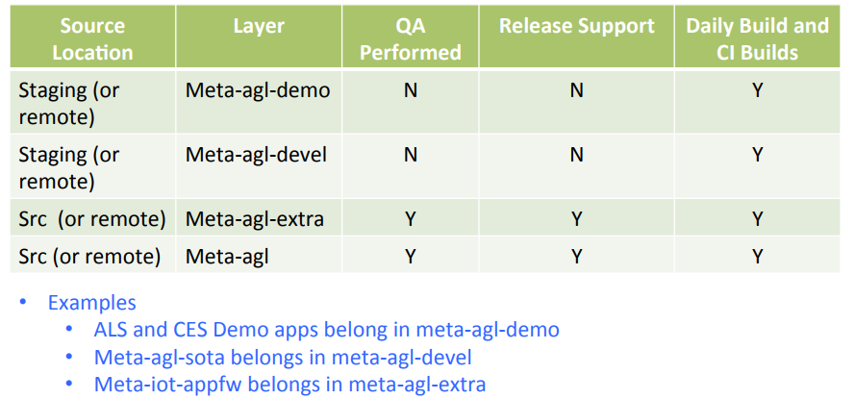
AGL Release Management

Slide 50
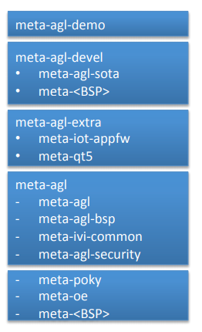
AGL Yocto Layers

Slide 51
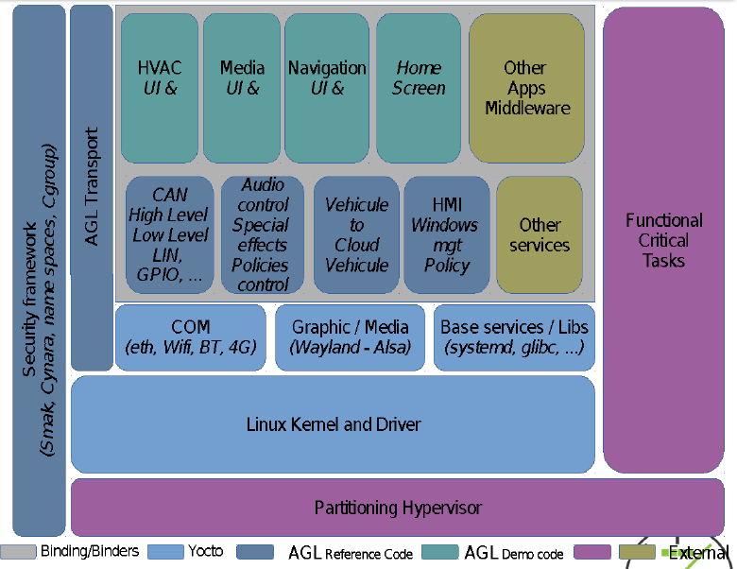
AGL Architecture

Slide 52
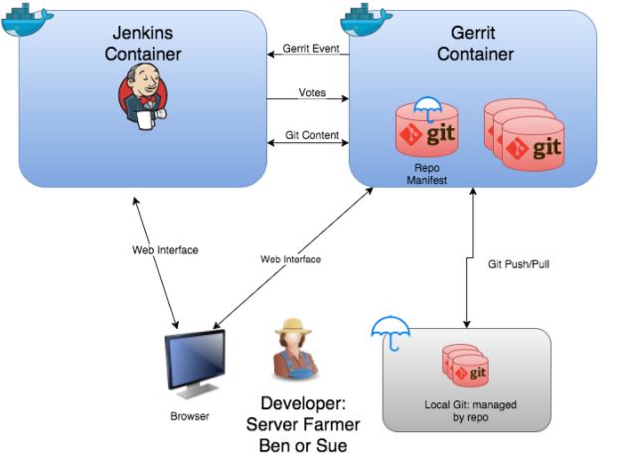
AGL Development Environment

Slide 53
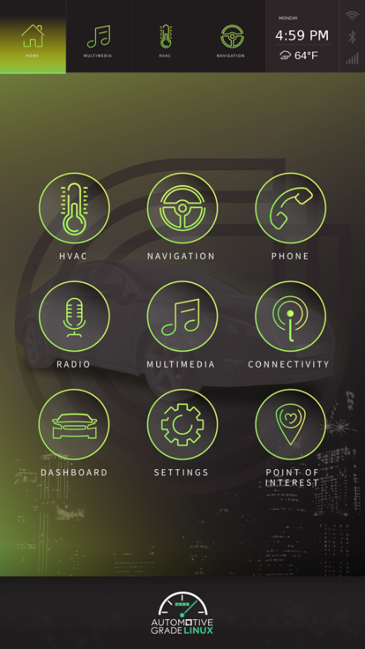
How to build AGL
$ repo init -u https://gerrit.automotivelinux.org/gerrit/AGL/AGL-repo
$ repo sync
$ source meta-agl/scripts/aglsetup.sh -m qemux86-64 agl-all-features
$ bitbake agl-demo-platform

Slide 54
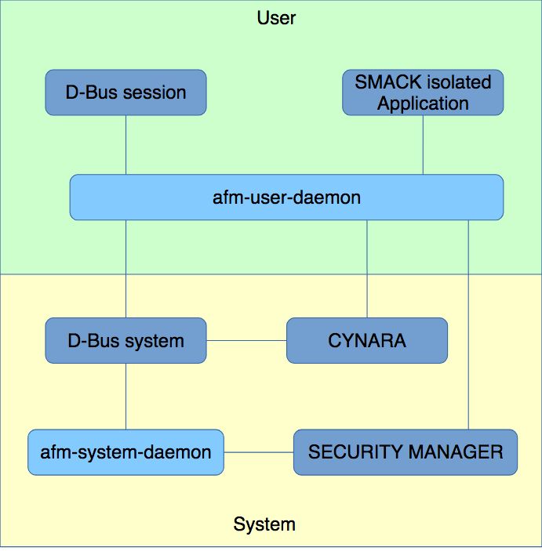
AGL Application Framework
SECURITY MANAGER: SMACK 컨텍스트, 규칙, 그룹 등의 데이터베이스를 생성
CYNARA: SECURITY MANAGER에서 생성한 규칙을 기반으로 사용자, 응용 프로그램별로 API 접근 권한을 처리
afm-system-daemon: 응용 프로그램 설치, 제거를 담당
afm-user-daemon: 응용 프로그램 상태, 사용자 컨텍스트, 시작, 중지, 종료와 같은 생명주기를 관리

Slide 55
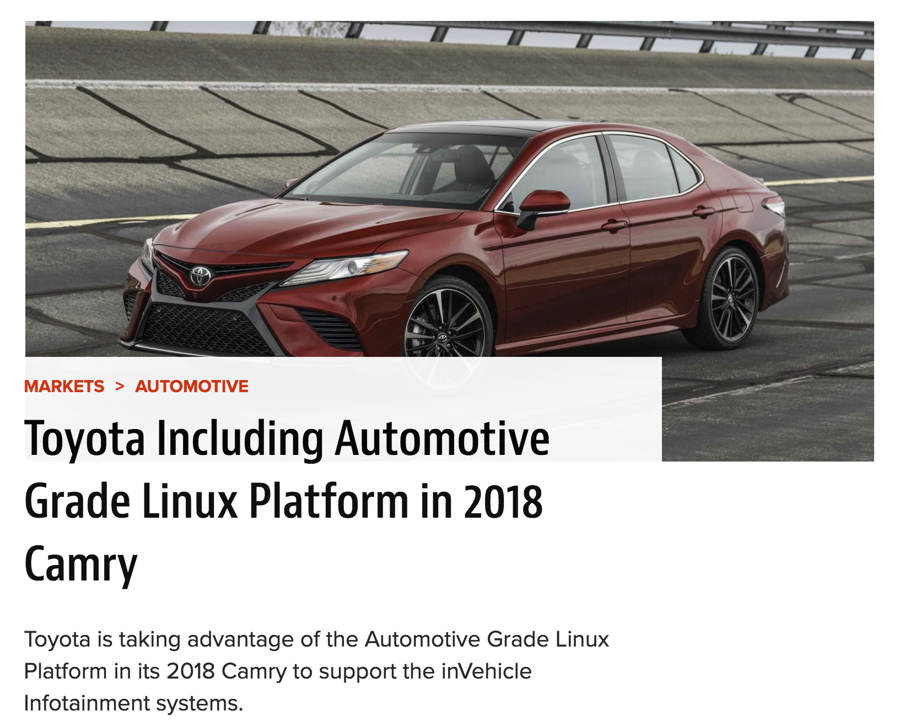
ALS 최신 동향
ALS (Automotive Linux Summit) 2017 참석
Place: Tokyo (5/31 ~ 6/2)
Toyota 가 주도하고 일본 업체들이 많이 참석하는
오픈 소스 단체로 느껴짐
GENVI에 비해 확실히 올라오는 오픈소스 코드량과
내용이 많음
참고로 TIZEN IVI는 명목만 유지하는 수준으로
Intel이 외주 업체에게 펀드를 주고 유지하는 형태임
AGL All Member Meeting
Oct 18-19, 2017
Hilton Dresden, Dresden, Germany
http://www.yocto.co.kr/2017/06/automotive-linux-summit-als-2017.html

Slide 56
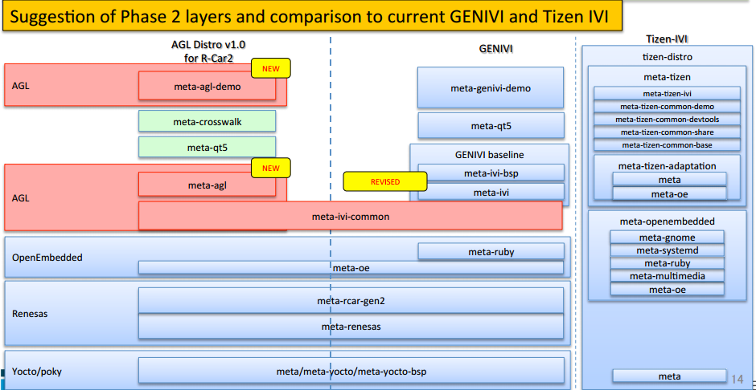
The Layers of AGL / GENIVI Distribution

Slide 57
GENIVI vs AGL
GENIVI is “Bring Your Own Platform”
For IVI
Multiple supplier can be compliant to GENIVI Specification
Different starting points
AGL is “Code first”
OEMs and suppliers use the same software base as starting point
Not For IVI, All Vehicle (Telematics …)
Collaborating on selected software components

Slide 58
Q & A

Slide 59
Reference
http://www.yoctoproject.org/
https://www.openwrt.org/
http://www.yocto.co.kr/
https://www.genivi.org/
https://www.automotivelinux.org/

